Slide 1
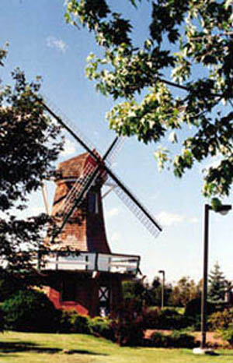
The Netherlands, also known as Holland
KNOWN FOR ITS
WINDMILLS OF
THE PAST

Slide 2
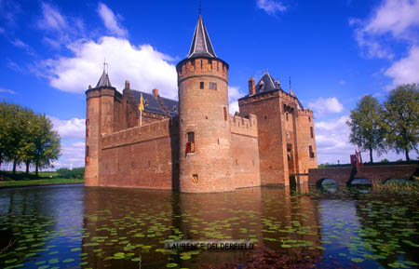
MEDIVAL CASTLES

Slide 3
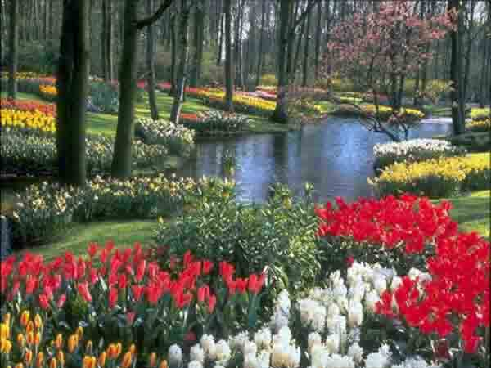
TULIPS ARE THE NETHERLANDS NUMBER ONE FLOWER

Slide 4
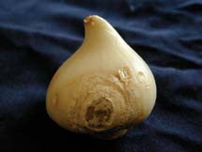
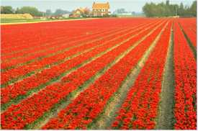
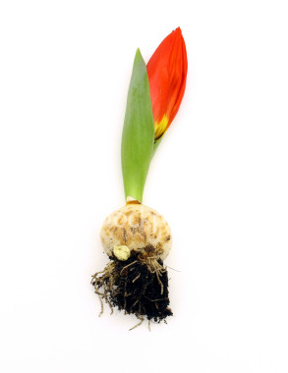
Dutch tulips are sent all over the world

Slide 5
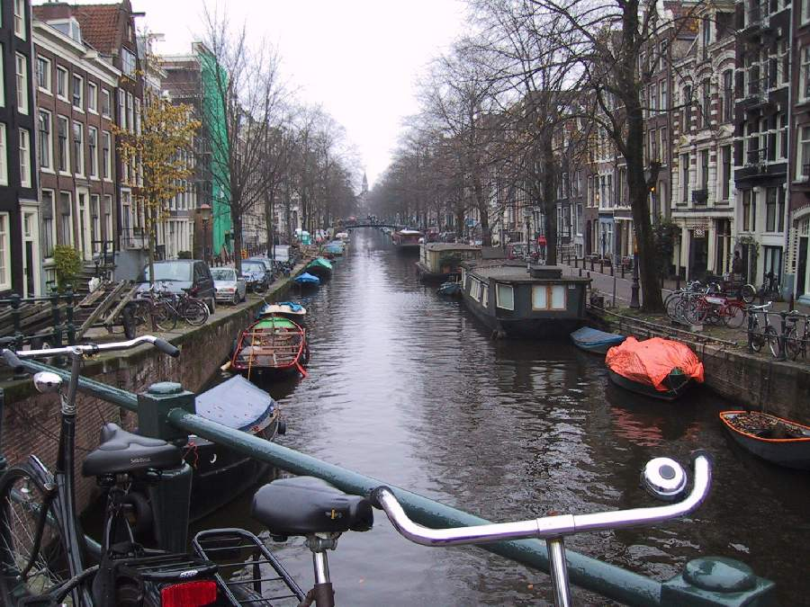

Slide 6
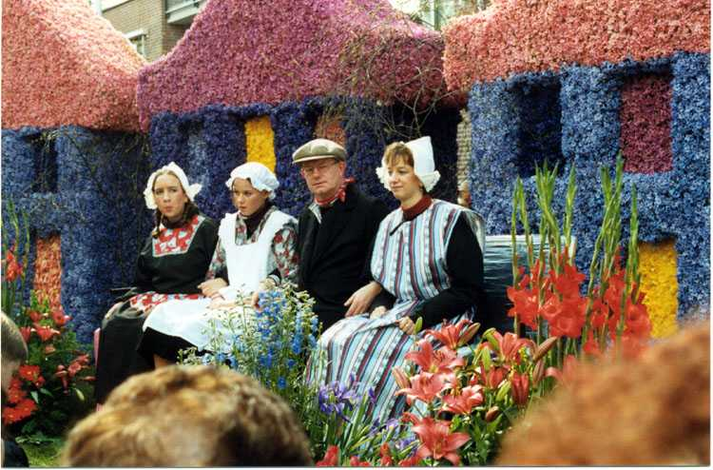
Traditional dress at a festival

Slide 7
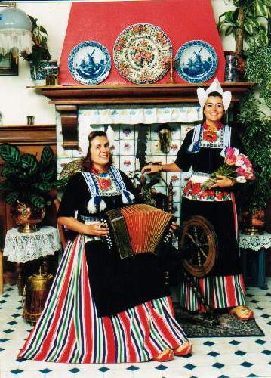

Slide 8
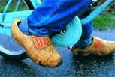
TRADTIONAL WOODEN SHOES

Slide 9
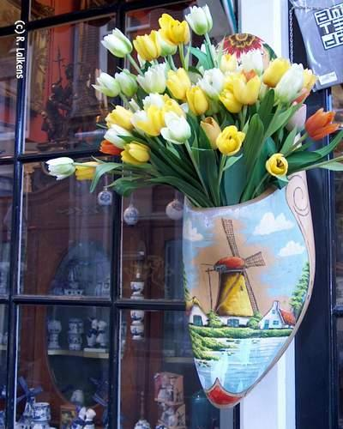
SHOES ARE NO LONGER FOR THE FEET

Slide 10
Traditional dance

Slide 11
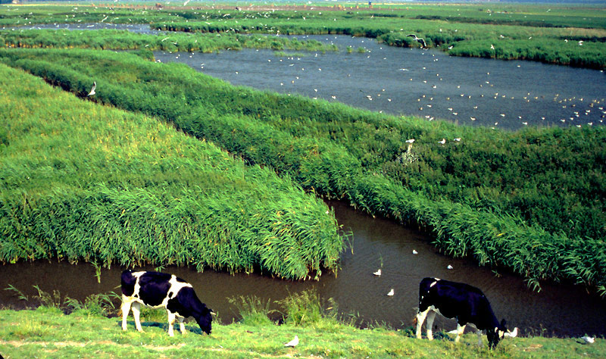
Trenches of the polders

Slide 12
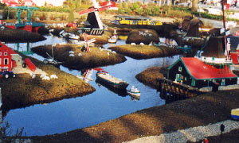
Living on the polders in not just for the cows

Slide 13
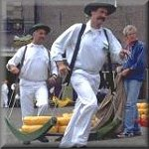
Carrying cheese wheels the traditional way

Slide 14
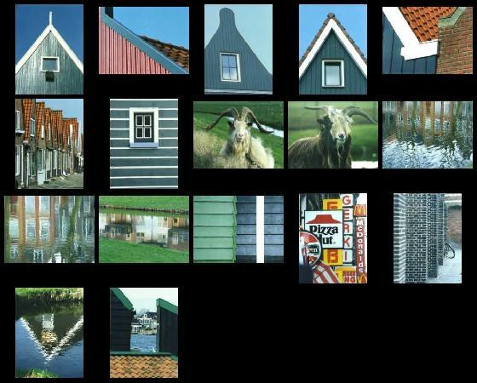
Netherlands, Holland: Tradition and Modern

Slide 15
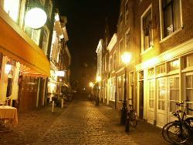
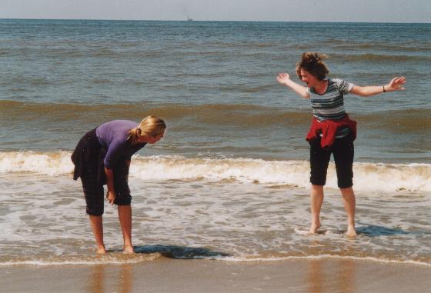
Wading in the
North Sea

Slide 16
This powerpoint was kindly donated to www.worldofteaching.com
http://www.worldofteaching.com is home to over a thousand powerpoints submitted by teachers. This is a completely free site and requires no registration. Please visit and I hope it will help in your teaching.

